Slide 1


The Power of Open Data: Creating a Smart City in Lima, OH
© Data II Equity 2021

Slide 2
Open Data in government is the practice of organizing and publishing community data so they are easily accessible to citizens and other advocates.
Benefits of Open Data:
Improved communication between municipal agencies
Greater transparency and trust between government and citizens
Increase opportunity to create Smart Cities
© Data II Equity 2021

Slide 3
Smart Cities use their own data and even those from similar cities to learn how to better serve their citizenry and reduce waste.
Benefits of Smart Cities:
Utilities better anticipate disruptions and service calls
Police more effectively target interventions, reduce adverse interactions, and engage the community in as partners in policing
Housing departments are more efficient in rooting out landlord violations and causes of urban blight
© Data II Equity 2021

Slide 4
Data Science uses complex math to both understand the environmental or human factors that contribute to events and predict when those events are likely occur.
Data Science is regularly used to predict plant growth, the weather next Tuesday, store items that are purchased together, the shows you will enjoy online, and your risk of cancer.
Data Science can be used to study Lima’s challenges, understand their causes, and develop strategies to efficiently address them.
© Data II Equity 2021

Slide 5
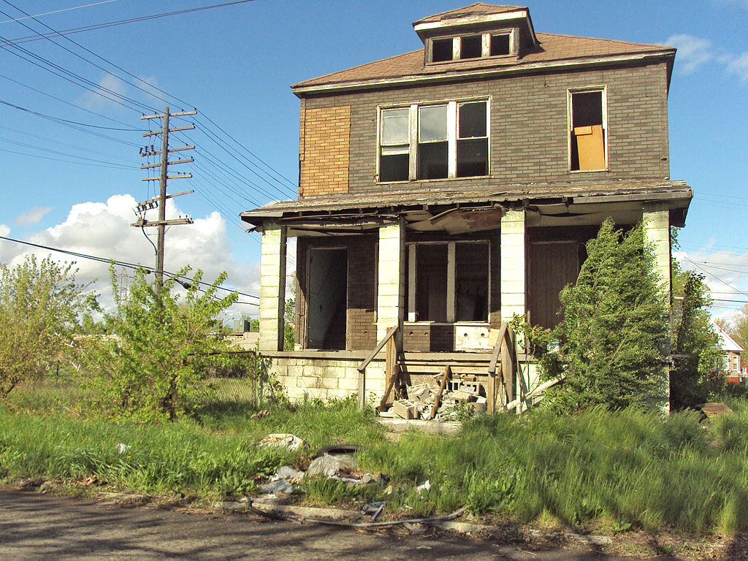
Example 1: Data Science in Housing
The Cincinnati of Cincinnati used tax, property, crime, and fire data to increase the positive identification of blighted properties to 70% of those inspected.¹
The City of Detroit used blight ticket, parcel, crime, and demolition data to better understand where ticketing was effective.²
© Data II Equity 2021

Slide 6

Example 2: Data Science in Policing
The City of Irving (Texas) and Southern Methodist University used police call and Google Maps data to redesign patrol areas for faster response times.³
The Charlotte-Mecklenburg (NC) Police Department and multiple institutions used call data to help officers reduce adverse public interactions.⁴
© Data II Equity 2021

Slide 7

Example 3: Data Science and Fire Safety
The City of New Orleans Fire Department used data science to identify homes both at greater risk of fire and less likely to have working smoke detectors. These addresses were targeted by the city’s smoke detector program.⁵
By Tumi-1983 - Own work, CC BY-SA 3.0, https://commons.wikimedia.org/w/index.php?curid=2944685
© Data II Equity 2021

Slide 8
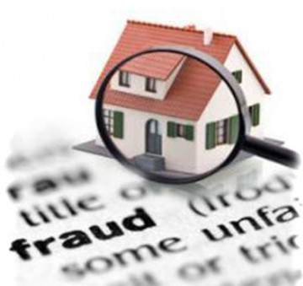
Example 4: Data Science and City Revenue
The City of San Francisco used property descriptions and sales records to identify those which were undervalued for tax avoidance purposes.⁶
© Data II Equity 2021

Slide 9
Building a Smart City
Leadership must identify common goals that can be achieved by data integration across city departments. ⁷
Pilot Projects should demonstrate the business case for data transparency and the use of data science to address community challenges. ⁸
Open Data must be pursued in a way that maximizes public accessibility while safeguarding the safety and privacy of citizens. ⁹
© Data II Equity 2021

Slide 10
Conclusions
Data science can be used to improve city services and protect public revenue:
Housing inspections
Public safety
Property fraud detection
Data science solutions will be fostered by open data sources that are integrated across city departments and readily accessible.
Current and future city leaders should identify how data science can be used to grow Lima into a smart city and how an open data can speed this transition.
© Data II Equity 2021

Slide 11
Sources
Reyes et al., “Early detection of properties at risk of blight using spatiotemporal data”. http://www.dssgfellowship.org/wp-content/uploads/2016/10/34_blancas.pdf.
Cell et al. “Understanding Blight Ticket Compliance in Detroit”. http://www.dssgfellowship.org//wp-content/uploads/2017/09/cell.pdf.
Allen, Brent. “Case Study: Using Crime Data and Open Source Data to Design a Police Patrol Area”. SMU Data Science Review, Vol. 1, No. 1, Article 12. https://scholar.smu.edu/cgi/viewcontent.cgi?article=1013&context=datasciencereview.
Carton et al. “Identifying Police Officers at Risk of Adverse Events”. https://www.kdd.org/kdd2016/papers/files/adf0832-cartonAemb.pdf.
Hillenbrand, Katherine. “Predicting Fire Risk: From New Orleans to a Nationwide Tool”. Data Smart City Solutions. https://datasmart.ash.harvard.edu/news/article/predicting-fire-risk-from-new-orleans-to-a-nationwide-tool-846.
Cano et al. “Streamlining Property Tax Appraisals”. https://datasf.org/science/ASR-StreamliningPropertyTaxAppraisals-Final.pdf
KPMG. “The Smart City Data Challenge”. https://assets.kpmg/content/dam/kpmg/au/pdf/2018/smart-city-data-challenge.pdf
Ibid.
Ibid.
All sources accessed 23 March 2021.
© Data II Equity 2021

Slide 12
Lima, Ohio
https://mharbur.wixsite.com/data2equity
© Data II Equity 2021

